Slide 1



Solving Water Access Issues with Data
This project aims to address water access challenges by utilizing data analytics and developing a comprehensive solution.
Presentation link :https://gamma.app/docs/t0nsvyx9a4t5fld?following_id=14xghw2mawv539l&follow_on_start=true

Slide 2

Sustainable Development Goal 6
1
Clean Water and Sanitation
2
Water Access Challenges
SDG 6 focuses on ensuring availability and sustainable management of water and sanitation for all.
Many regions face water scarcity, poor sanitation, and inadequate infrastructure, impacting human health and development.
Data-Driven Solutions
3
This project leverages data to identify areas with limited water access and develop tailored solutions.

Slide 3

Problem Definition and Significance
Limited Water Access
Inadequate Infrastructure
Socioeconomic Impact
Many communities struggle to access clean and safe drinking water, leading to health problems and hindering development.
Aging water infrastructure and lack of investment in new systems contribute to water scarcity and contamination.
Water scarcity disproportionately affects vulnerable populations, impacting their livelihoods, education, and overall wellbeing.

Slide 4

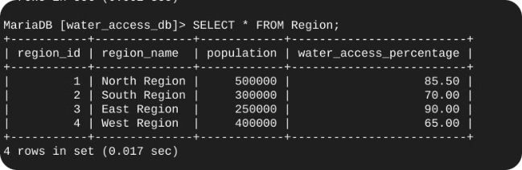
Database Schema
Table Name
Columns
Region
region_id, region_name, population, water_access_percentage
Water_Source
source_id, source_type, capacity, location
Water_Access
access_id, region_id, source_id, access_date, access_status

Slide 5
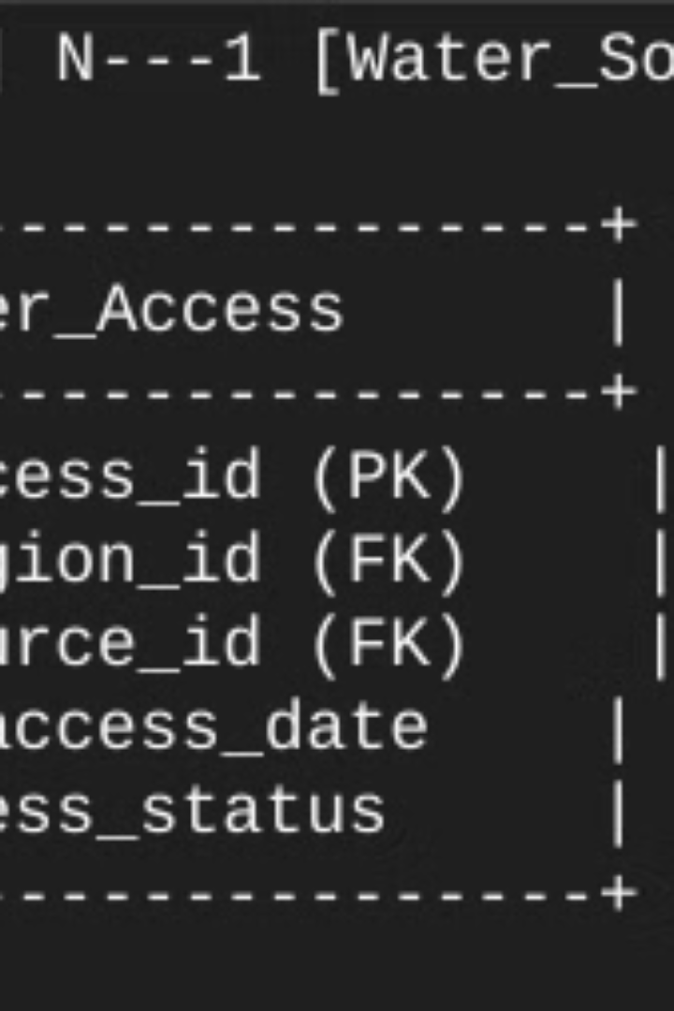



Entity Relationship Diagram
Region
Holds information about geographic regions, including their population and water access percentage.
Water_Access
Tracks water access data for different regions and water sources, including access date and status.
Water_Source
Contains details about the different water sources, such as type, capacity, and location.

Slide 6
SQL Queries and Outcomes
Retrieving Data
Data Analysis
SQL queries are used to extract data from the database and analyze water access trends.
The results of the queries provide insights into water access patterns and help identify areas requiring attention.
Region names and their water access percentages
Water source types and their access status
Region with highest water access percentage
Number of operational water sources per region
Water source types with high operational status
Average water access percentage per region
Regions with the most operational sources
Areas with the lowest average water access

Slide 7
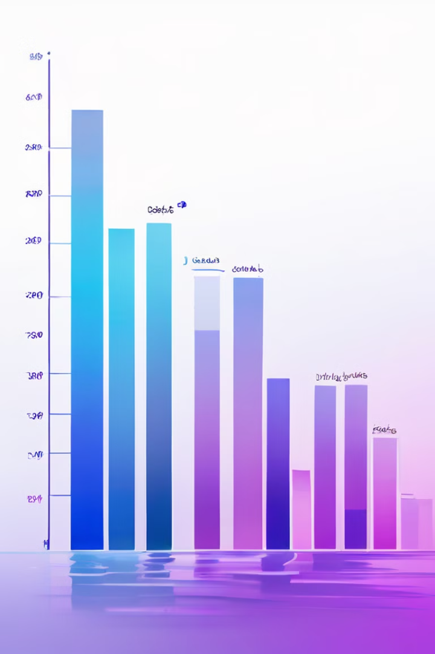
Insights from Data Analysis
2
Infrastructure Needs
Water Access Gaps
Data reveals regions with a shortage of operational water sources, highlighting the need for infrastructure development.
1
The analysis identifies regions with significantly lower water access rates compared to others.
Sustainable Practices
3
Population Density
4
The analysis shows a correlation between population density and water access, suggesting a need for tailored solutions.
Data helps assess the impact of existing water management practices and identify areas for improvement.

Slide 8
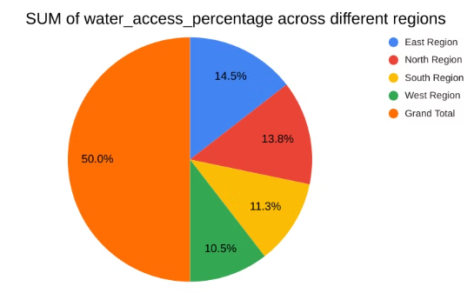
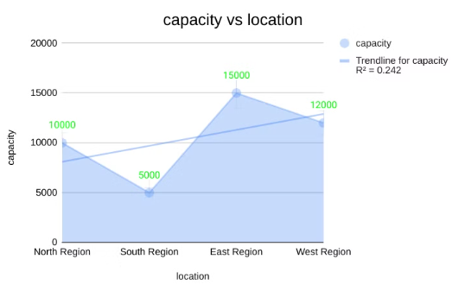
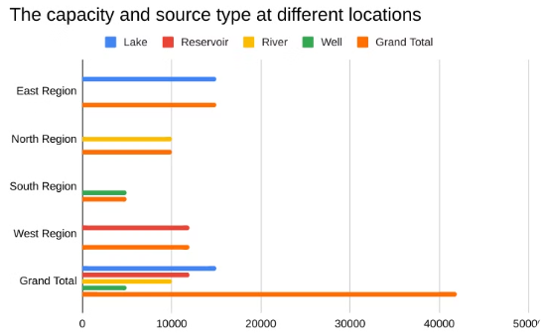
Excel Dashboard
Water Source Distribution
Water Access Trends
water source Analysis
The dashboard visualizes the proportion of different water source types across the regions.
The dashboard tracks water access trends over time, highlighting progress and areas requiring improvement.
The dashboard presents a map with regions color-coded according to their water access levels and source.

Slide 9

Summary of Findings and Recommendations
Infrastructure Investment
1
Prioritize investment in water infrastructure, including new wells, pipelines, and treatment facilities.
Water Conservation Programs
2
Implement water conservation programs to promote efficient water usage and reduce waste.
Community Engagement
3
Foster community participation in water management initiatives, ensuring local ownership and sustainability.
Data-Driven Monitoring
4
Continue collecting and analyzing data to monitor progress, evaluate interventions, and adapt solutions.

Slide 10

The Path Forward: Using Data to Drive Sustainable Water Access
By leveraging data analytics, we can develop tailored solutions that address specific water access challenges, ensuring a sustainable future for all.

